Slide 1

Object Detection for Autonomous Vehicles
Presented by:
Jashwanth Neeli
Megha Kaavali Mahadevappa

Slide 2

Object Detection Progress
Introduction
Literature Review
Methodology
Results/Discussion
Conclusions
Future Work
References

Slide 3
Introduction:
Object detection and tracking are crucial aspects of computer vision, with wide-ranging applications such as surveillance and autonomous navigation.
The progress in computational power and the accessibility of extensive public datasets have driven research in these fields.
The primary goals include identifying objects in images or videos, tracking their movements, and analyzing their behavior.

Slide 4
In the process of creating a video dataset, various factors affecting picture quality degradation during image capture, such as low image resolution, noise, and blur, are taken into consideration.
The next step in video analysis is object classification, which involves categorizing specific objects in a video frame as humans, animals, birds, automobiles, and other moving objects.
Finally, object tracking involves identifying and interpreting target objects as trajectories in successive video frames. With advancements in technology, research has shifted towards automated object detection and tracking.

Slide 5

Dataset:
"Our main goal is to utilize a customized dataset, specifically a video streaming dataset."
The input video file contains footage of the streets of Chicago, which we recorded. It includes various types of vehicles such as buses, bikes, cars, and bicycles, as well as streetlights and pedestrians. We utilized a coco dataset with 80 labels to help identify these objects.
The input data file has been converted into 3500 images with corresponding labels. These images have been further classified into training and validation sets. The training set consists of approximately 2850 images, while the validation set contains around 650 images.

Slide 6
Literature Review: Object Detection Techniques
Background Subtraction for Object Detection: Background subtraction is a key method to detect objects by analyzing pixel differences between current and previous frames.
Optical Flow in Object Detection: Optical flow techniques calculate motion clusters from image features, aiding in object detection algorithms.
Complementary Methods for Object Detection: Object detection methods utilize frame difference, optical flow, and background subtraction for accurate identification.

Slide 7
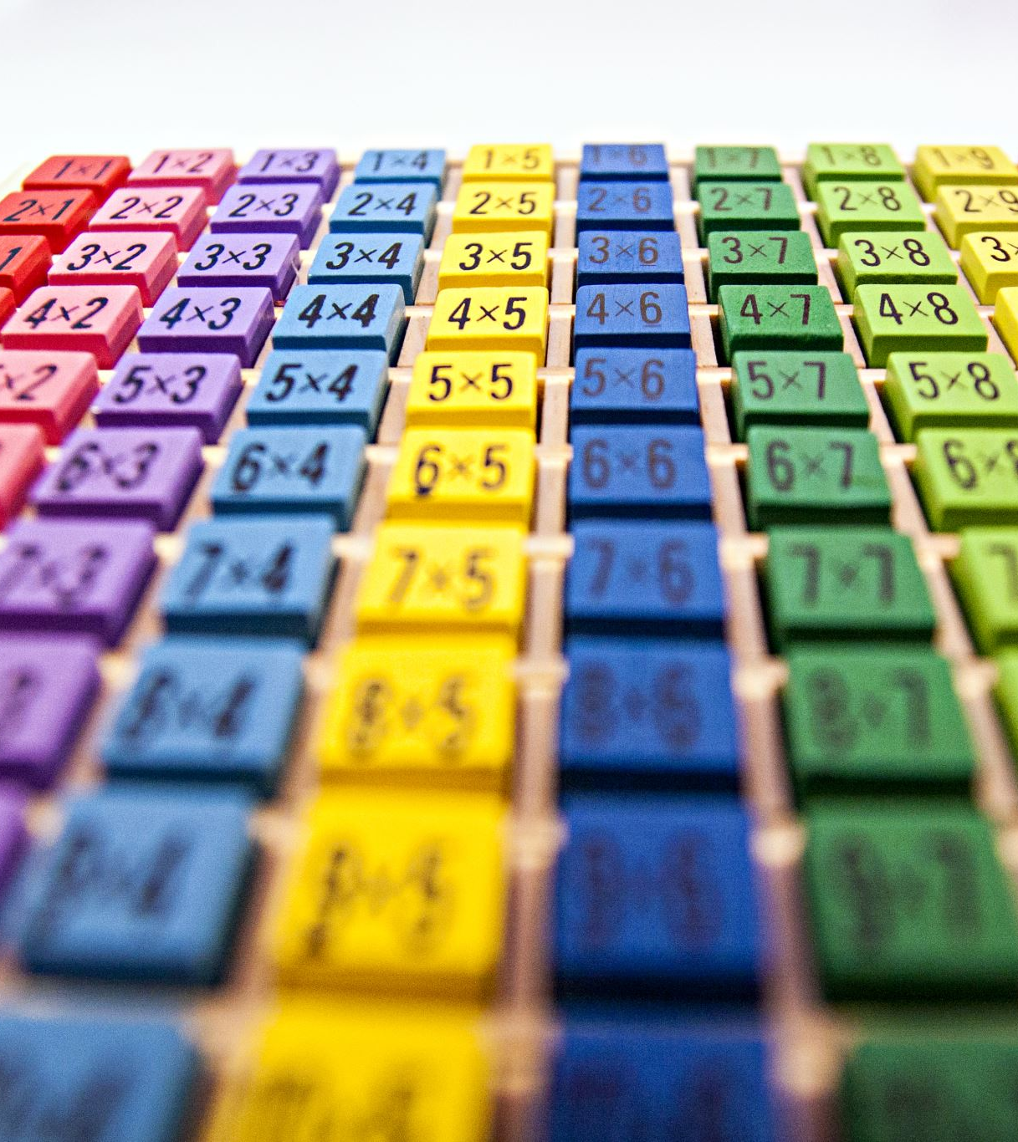
Object Classification Methods
Motion-Based Object Classification: Authors like Hitesh A. Patel proposed motion-based classification techniques, which do not rely on predefined patterns but may face challenges in identifying stationary objects.
Texture-Based Object Classification: Innovative approaches like texture-based image classification by certain authors leverage gradient orientation for better quality at the cost of computational time.
Shape-Based Object Classification: Studies by authors like Salve and Jondhale focus on shape-based classification methods that employ simple pattern matching, suitable for graph matching applications.

Slide 8

Object Tracking Methods
Point Tracking Technique Overview: Point tracking involves representing mobile objects with focal points and addressing challenges like erroneous detection and occlusion.
Kernel Tracking Implementation Analysis: Kernel tracking calculates non-stationary object regions between frames, improving the accuracy of tracking in dynamic scenarios.
Significance of Silhouette Tracking: Silhouette tracking utilizes object models to identify regions in images, enhancing tracking robustness in various surveillance applications

Slide 9
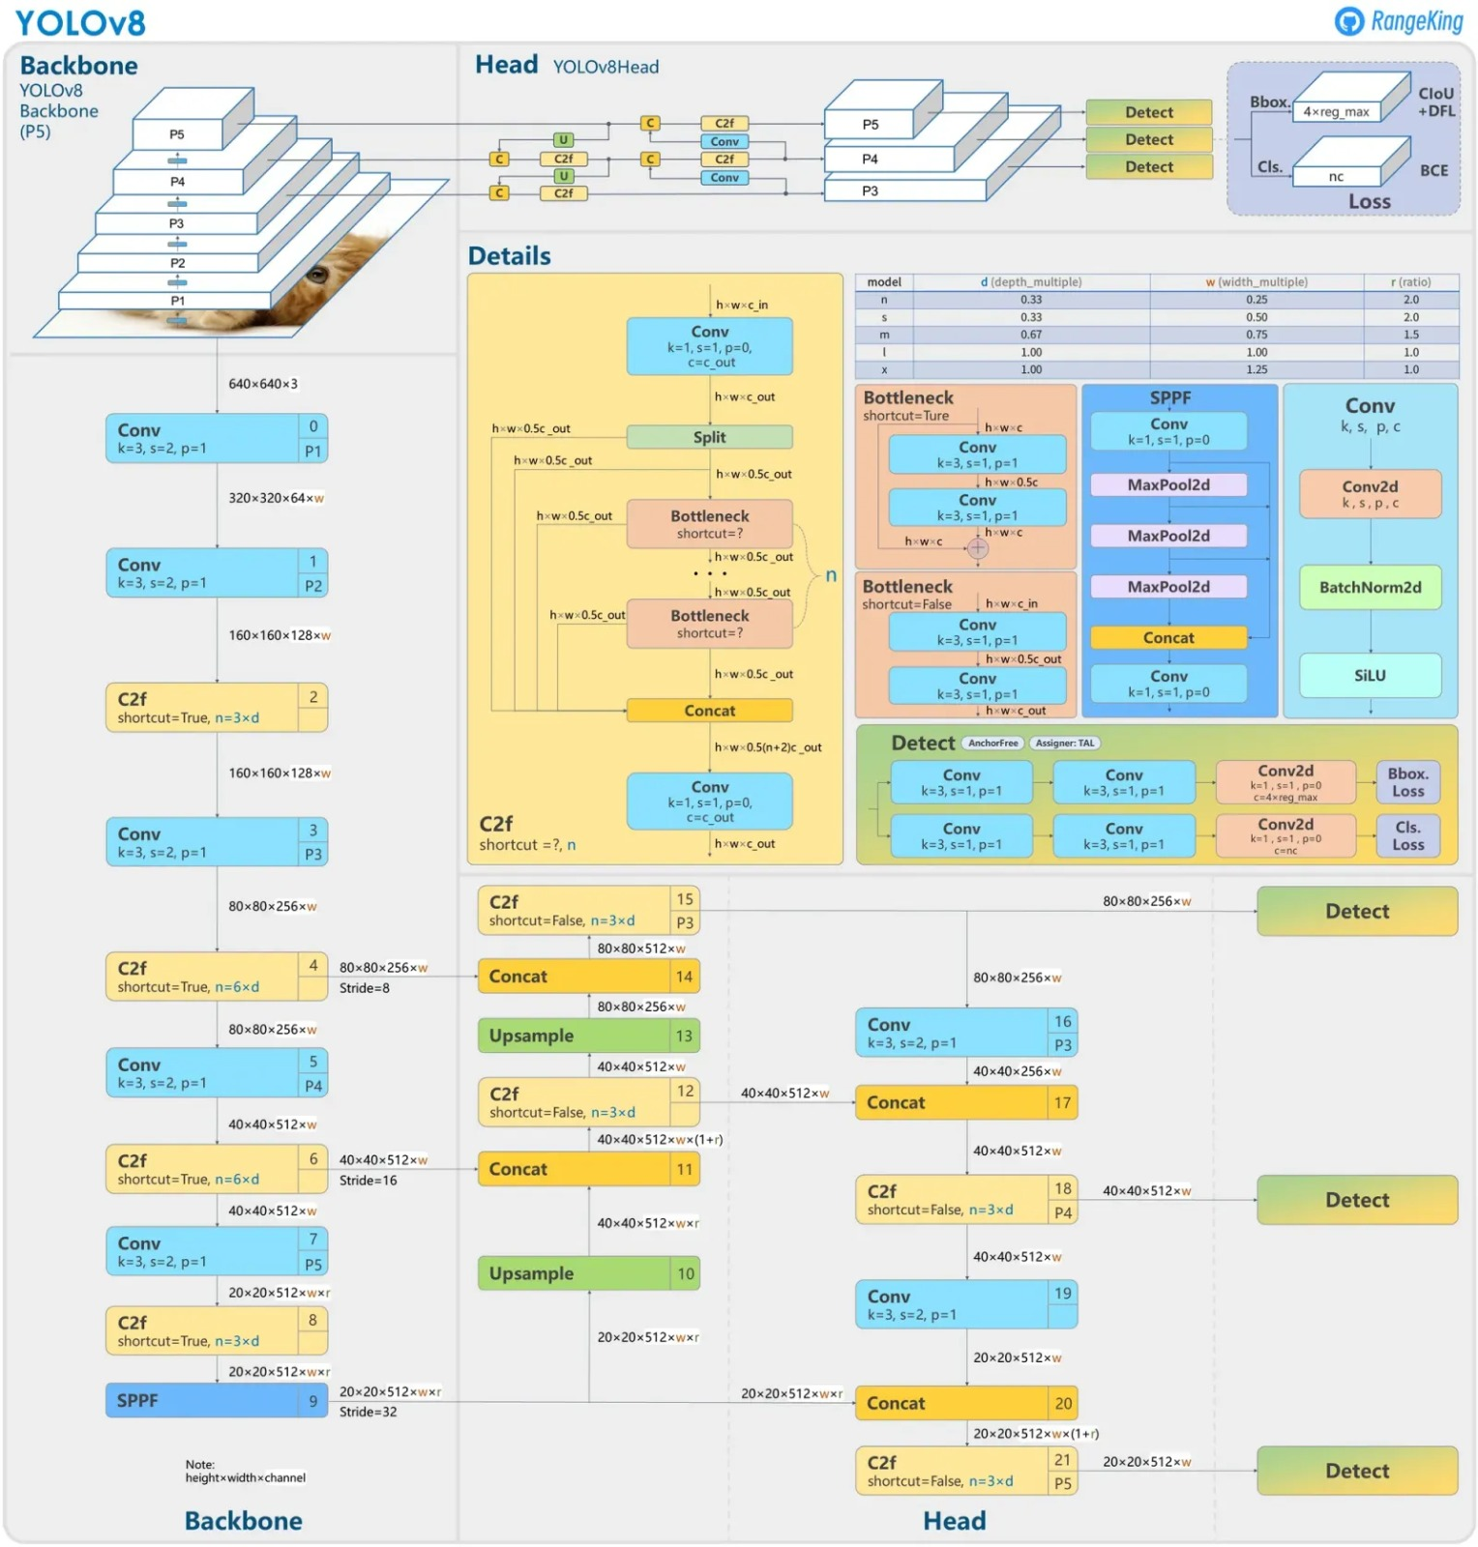
Methodology:
YOLOv8 demonstrates high accuracy on COCO. For instance, the YOLOv8m model, which is the medium-sized model, achieves a 50.2% mAP when evaluated on COCO.
When tested against Roboflow 100, a dataset designed to assess model performance across different task-specific domains, YOLOv8 outperformed YOLOv5 by a significant margin. You can find more detailed performance analysis in the later sections of the article. YOLOv8 demonstrates high accuracy on COCO.
For instance, the YOLOv8m model, which is the medium-sized model, achieves a 50.2% mAP when evaluated on COCO.
When tested against Roboflow 100, a dataset designed to assess model performance across different task-specific domains, YOLOv8 outperformed YOLOv5 by a significant margin. You can find more detailed performance analysis in the later sections of the article.

Slide 10
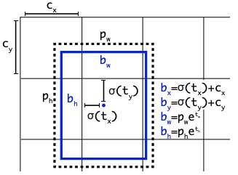
In object detection, the goal is to identify and locate objects within an image. This is different from image classification, where there may be multiple objects of the same or different classes in the image, and object detection aims to predict all these objects accurately.
Object detection models handle this task by splitting the prediction process into two parts. First, they predict a bounding box using regression, and then they predict a class label through classification.
Anchor-free detection reduces the number of box predictions, which speeds up Non-Maximum Suppression (NMS). NMS is a complex post-processing step that filters through candidate detections after the inference.

Slide 11
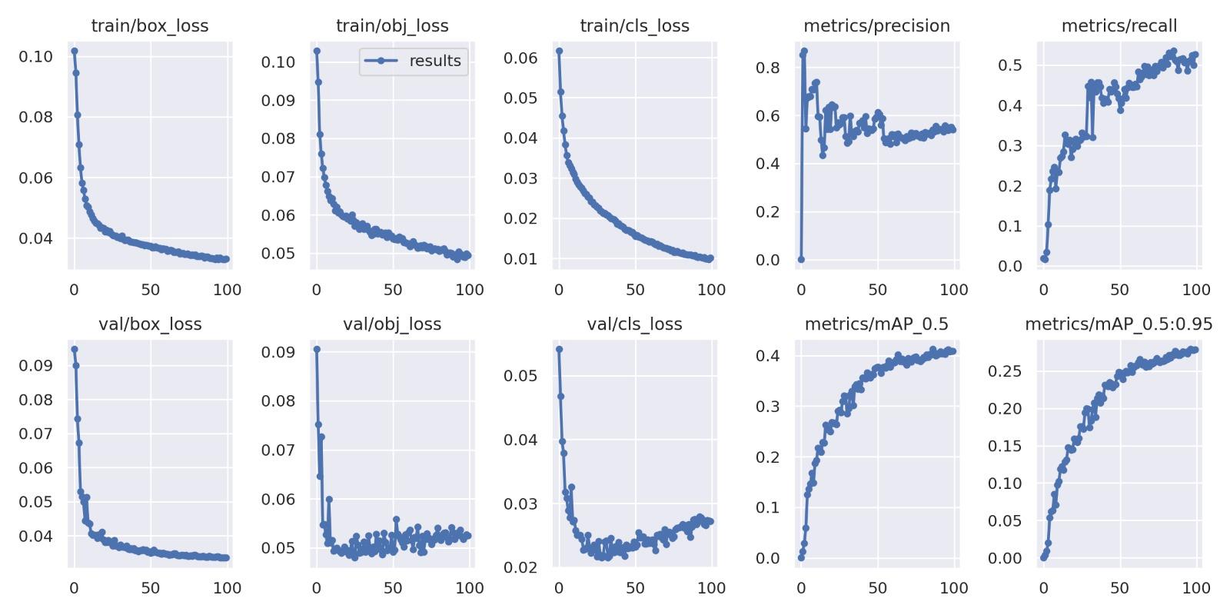
Results:
The model has shown significant improvement in all loss metrics (box, objectness, and classification), indicating effective learning from the training data.
Both precision and recall have improved over time, showcasing enhanced performance in accurately identifying and classifying objects.
Additionally, there has been a notable improvement in mAP scores at IoU thresholds of 0.5 and from 0.5 to 0.95, suggesting that the model's predictions are aligning more closely with the ground truth annotations in terms of object presence and location.

Slide 12
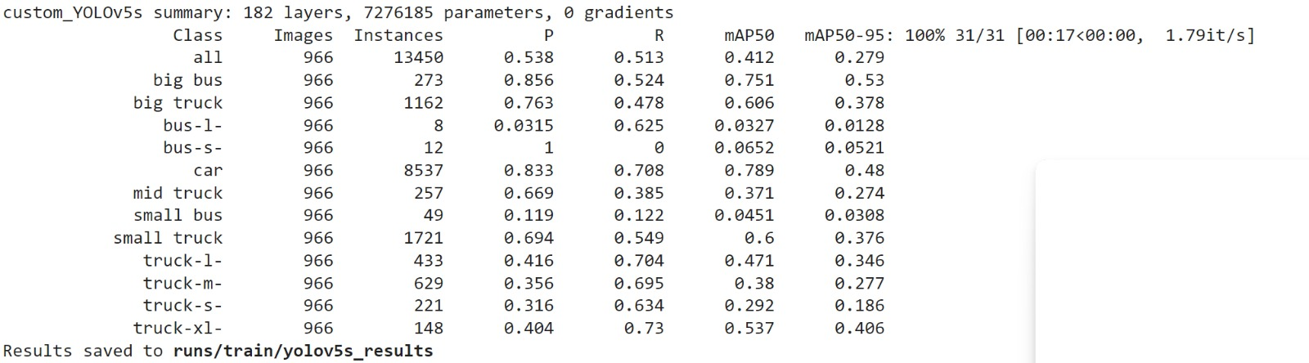
Please take note of the following observations: Some classes, such as "bus-l-" and "bus-s-", have very low metrics. This could be attributed to either very few instances in the dataset or high similarity with other classes, leading to misclassification. The noticeable difference in performance across various vehicle types indicates that the model could potentially improve with more balanced data, more robust feature extraction tailored to the underperforming classes, or additional training epochs.

Slide 13
Conclusion:
Object detection models are trained using images labeled with objects’ precise locations. This helps the models to learn to identify and categorize different objects accurately.
However, the performance of these models can vary across different object classes.
This suggests a need for continual model optimization through analysis of misclassifications, augmentation of training data for underperforming categories, or further tuning of the model parameters.

Slide 14

Future Work:
Implementation of lane line detection.
Training the model, and checking the recall, precision, and map score for lane line detection.

Slide 15

THANK YOU

